Slide 1

Harlem to Toronto Where to Go?
Prieshecumar Premegi
6 May 2020

Slide 2
Business Problem
Manhattan is the smallest and most densely populated borough of New York City. With 72,033 people per square mile in 2015, this borough has density higher than any individual American city (1).
Both Manhattan and Old Toronto are boroughs of main cities in US and Canada. It's very difficult to compare these two neighbours due to its difference in demographics but also due to the way these boroughs have split their neighbourhoods.
Can you help me find Harlem like neighbourhoods in Toronto?

Slide 3
Data acquisition and cleaning
Toronto boroughs and neighbourhoods https://en.wikipedia.org/wiki/List_of_postal_codes_of_Canada:_M, merged with geolocation data from https://cocl.us/Geospatial_data
Harlem’s geolocation: latitude 40.8115504; longitude -73.9464769
100 venues in a radius of 750 meters from Foursquare using geolocation data
Converting list of 2766 venue details (name, location and category) into top 10 most common venues per neighborhood

Slide 4
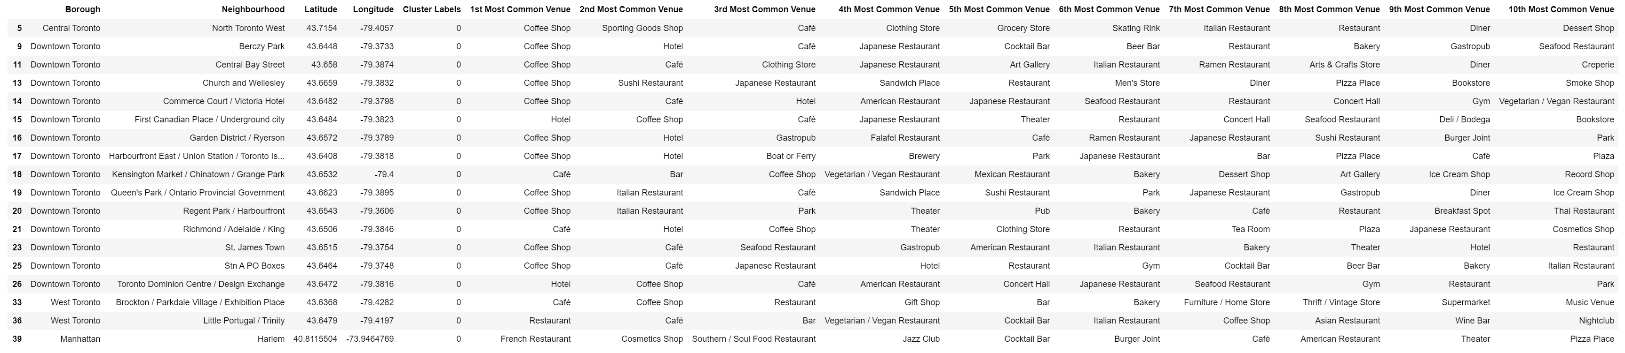
K-means clustering
The analysis shows that the borough of Downtown Toronto is by far the borough with more neighbourhoods classified and clustered as like Harlem. There some neighbourhoods in West Toronto and Central Toronto that share the same profile.

Slide 5
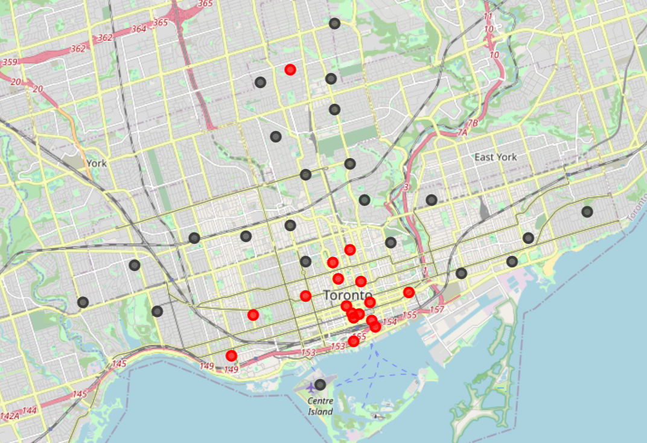
K-Means Clustering
You can see the most common top 10 venue categories in each neighbourhood that are part of Harlem's cluster as well as a map with the location of each borough (in red).
I can also observe that Harlem's top 4 common venue categories are not in any of the suggested boroughs. You can only see a match from the 5th venue category, "Cocktail Bar", matching the boroughs of Little Portugal, Trinity and Berczy Park.

Slide 6
conclusion
This project was create to help me identify neighbourhoods in Old Town Toronto that are similar Harlem (Manhattan) due to a recent change in career that is forcing me to leave the place I love. To help me fid the best places in Toronto, that I will enjoy as I do in Harlem, I have used data from Foursquare to list the most common venues around 750 meters of each neighbourhood in Toronto, to find those which match with Harlem's most common venues.
Downtown Toronto is the place to start for, as it has the most neighbourhoods in the same cluster as Harlem.

